Slide 1
Guaranteeing Partial State Synchronization for UAV Platoon under Message or UAV Loss
Baisakhi Chatterjee & Dr. Rudra Dutta
Department of Computer Science, North Carolina State University, USA

Slide 2







INTRODUCTION
Autonomous Multi-UAV Groups have a variety of applications
Network Coverage
Search and Rescue
Traffic Surveillance
Thus, communication in autonomous UAVs for dynamic path planning is an area of considerable research interest
Notes:
Autonomous Multi-UAV Groups have a variety of applications
Network coverage is the problem of optimizing the placement of mobile stations to increase connectivity between groups of users. UAVs are uniquely suited for this task.
Another activity where UAVs thrive is that of Search and Rescue. UAVs can locate groups of survivors in potentially dangerous conditions and alert rescue organizations.
Traffic surveillance, too benefits from the UAVs usage. These devices can monitor traffic patterns and detect anomalous behaviours.

Slide 3
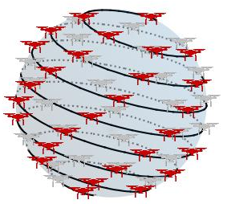
MOTIVATION
In our previous work, we focused on studying the dependence of communication on mission correctness
Exemplar of Plume Wrapping
Problem of finding the boundary of a gaseous, possibly toxic, plume
Multi-UAV communication & adaptive trajectory planning based on dynamic data
Previously, we considered an abstract high-level view of the communication channel
In this work, we have modeled a real-world lossy channel.
The goal of our research is to show that we can guarantee partial multiparty synchronization in a distributed autonomous system
Notes:
While it is reasonable to assume that the starting phase of a plume with pollutants lighter than air will assume a roughly spherical shape [11], this technique poses a challenge when the contaminants are heavier than air and drop to the ground.

Slide 4
ALGORITHM

Slide 5
DESIGN
Initialization
Initial Sphere Formation
Stop-Click Phase
Termination

Slide 6
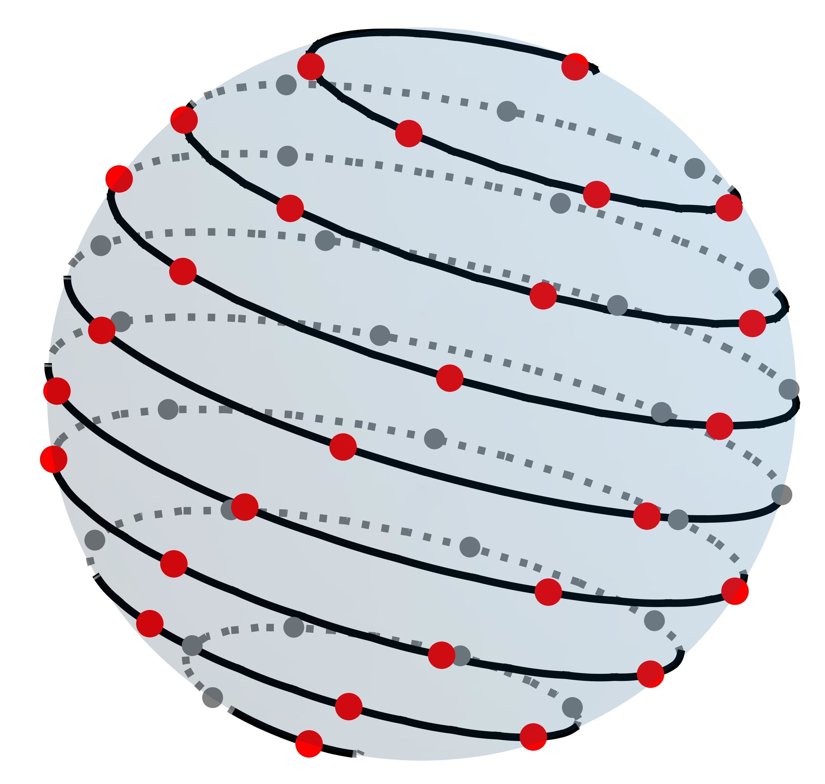
OVERVIEW
Initialization
UAVs are placed in an arbitrary configuration
A single UAV searches for the boundary
Stops and broadcasts message to other UAVs when boundary is detected
Initial Sphere Formation
Other UAVs calculate target position on a sphere at origin using Fibonacci Sphere Formula
UAVs translate sphere to the boundary
UAVs move to the target position

Slide 7
OVERVIEW
Stop-Click Phase
Synchronization Phase where each UAV waits for n updates to make a ‘decision’.
STOP is triggered when the UAV has received updates from all group members
During CLICK, the UAV moves to its target point
For plume wrapping, decisions are Expansion or Rotation
Termination
The algorithm finishes when every other UAV is a the boundary region

Slide 8
EXPANSION & ROTATION
Expansion
Movement of every UAV such that radius of the Fibonacci Sphere is increased
Occurs when every point is INSIDE the plume boundary
Rotation
Movement of every UAV such that Fibonacci Sphere moves towards the plume
Occurs when at least one point is OUTSIDE the plume boundary

Slide 9
SYNCHRONIZATION LOSS
As is evident, Stop-Click Phase requires multiparty synchronization
This is made difficult due to
Message Loss as a result of unreliable channel
UAV Loss due to system fault
The problem can be generalized to any UAV platoon mission where agents require updated state knowledge.
Our algorithm guarantees partial multi-party synchronization

Slide 10
SYNCHRONIZATION LOSS
Ideal Conditions
Message Loss
Reached!
One UAV is outside the plume
Every UAV is inside the plume
Message is not delivered
Rotation Chosen
Expansion Chosen
Incorrect Decision Taken
10

Slide 11
MULTI-PARTY SYNCHRONIZATION
Three key components are added to ensure partial multi-party synchronization.
Sequence Numbers – Enforces order on states and limits desynchronization.
Message Retransmission Timer – Retransmits Message after a certain time.
UAV Loss Timer – Marks UAV as lost after it has not been heard from for a long time.
Recv
Msg from UAV_{X}?
Y
N
N Msgs Recvd for State?
UAV_{X} Timer Expired?
Next State
Mark UAV_{X} Lost

Slide 12
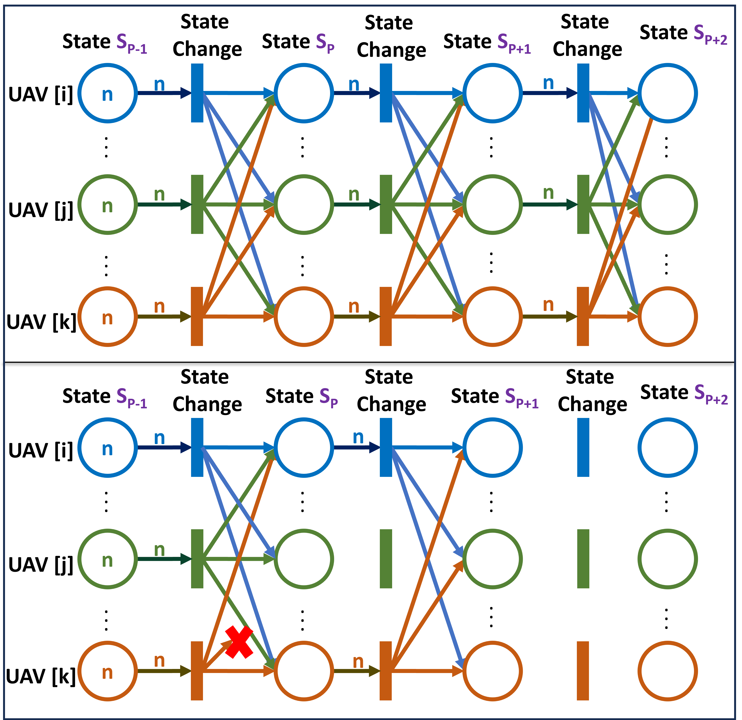
SEQUENCE NUMEBRS
Maintains current state information
States are monotonically increasing
Messages are accepted based on state information
If current state of UAV_{X} is P, it has received all (P-1)^{th} messages from neighbors and will only accept P^{th} messages
If some UAV_{Y} has received all P^{th} messages, it will advance to (P+1)
Guarantees Bounded Variation in States
Notes:
No Message Loss
Each UAV starts with n tokens which are consumed during state change
n tokens are then received via state information
Message Loss
Message from UAV_{k} to UAV_{j} is lost
UAV_{j} is thus stalled thinking UAV_{k} is still at S_{p-1}

Slide 13
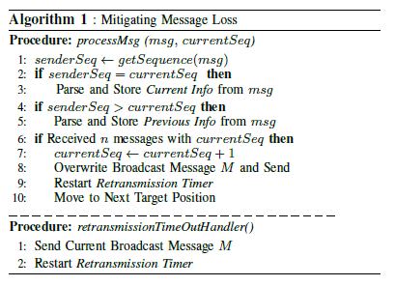
Message Retransmission
Retransmit messages for a state after timer expires
Message contains information about current and previous state
If UAV_{X} is at state P, other UAVs are at (P-1), P or (P+1)
UAVs at (P+1) ignore this message
UAVs at P accept this message
UAVs at (P-1) extract previous state info

Slide 14
UAV Loss
N-bit timer for each UAV, including self
Keeps track of how often one agent has heard from other agents
If some UAV has not communicated for a long time, the UAV is marked as lost, and subsequent messages from the UAV are rejected.
Tamp Down Mode – When a UAV is marked as “Lost” all other UAVs Tamp Down for a time and reject all messages
This allows every UAV time to mark the offending UAV as lost
Agile Mode – UAVs purge the existing state information and rebuilt the Information Data structure, accepting messages only from UAVs who have also marked the offending UAV as “Lost”

Slide 15
WORKING EXAMPLE
Message Loss
UAV Loss
Faulty UAV Aborts Mission
Message is not delivered
UAV suffers Transmitter Fault
Correct Decision is Taken
Other UAVs take a decision without faulty UAV’s data
Retransmission Occurs
Other UAVs wait till Timeout

Slide 16
RESULTS

Slide 17
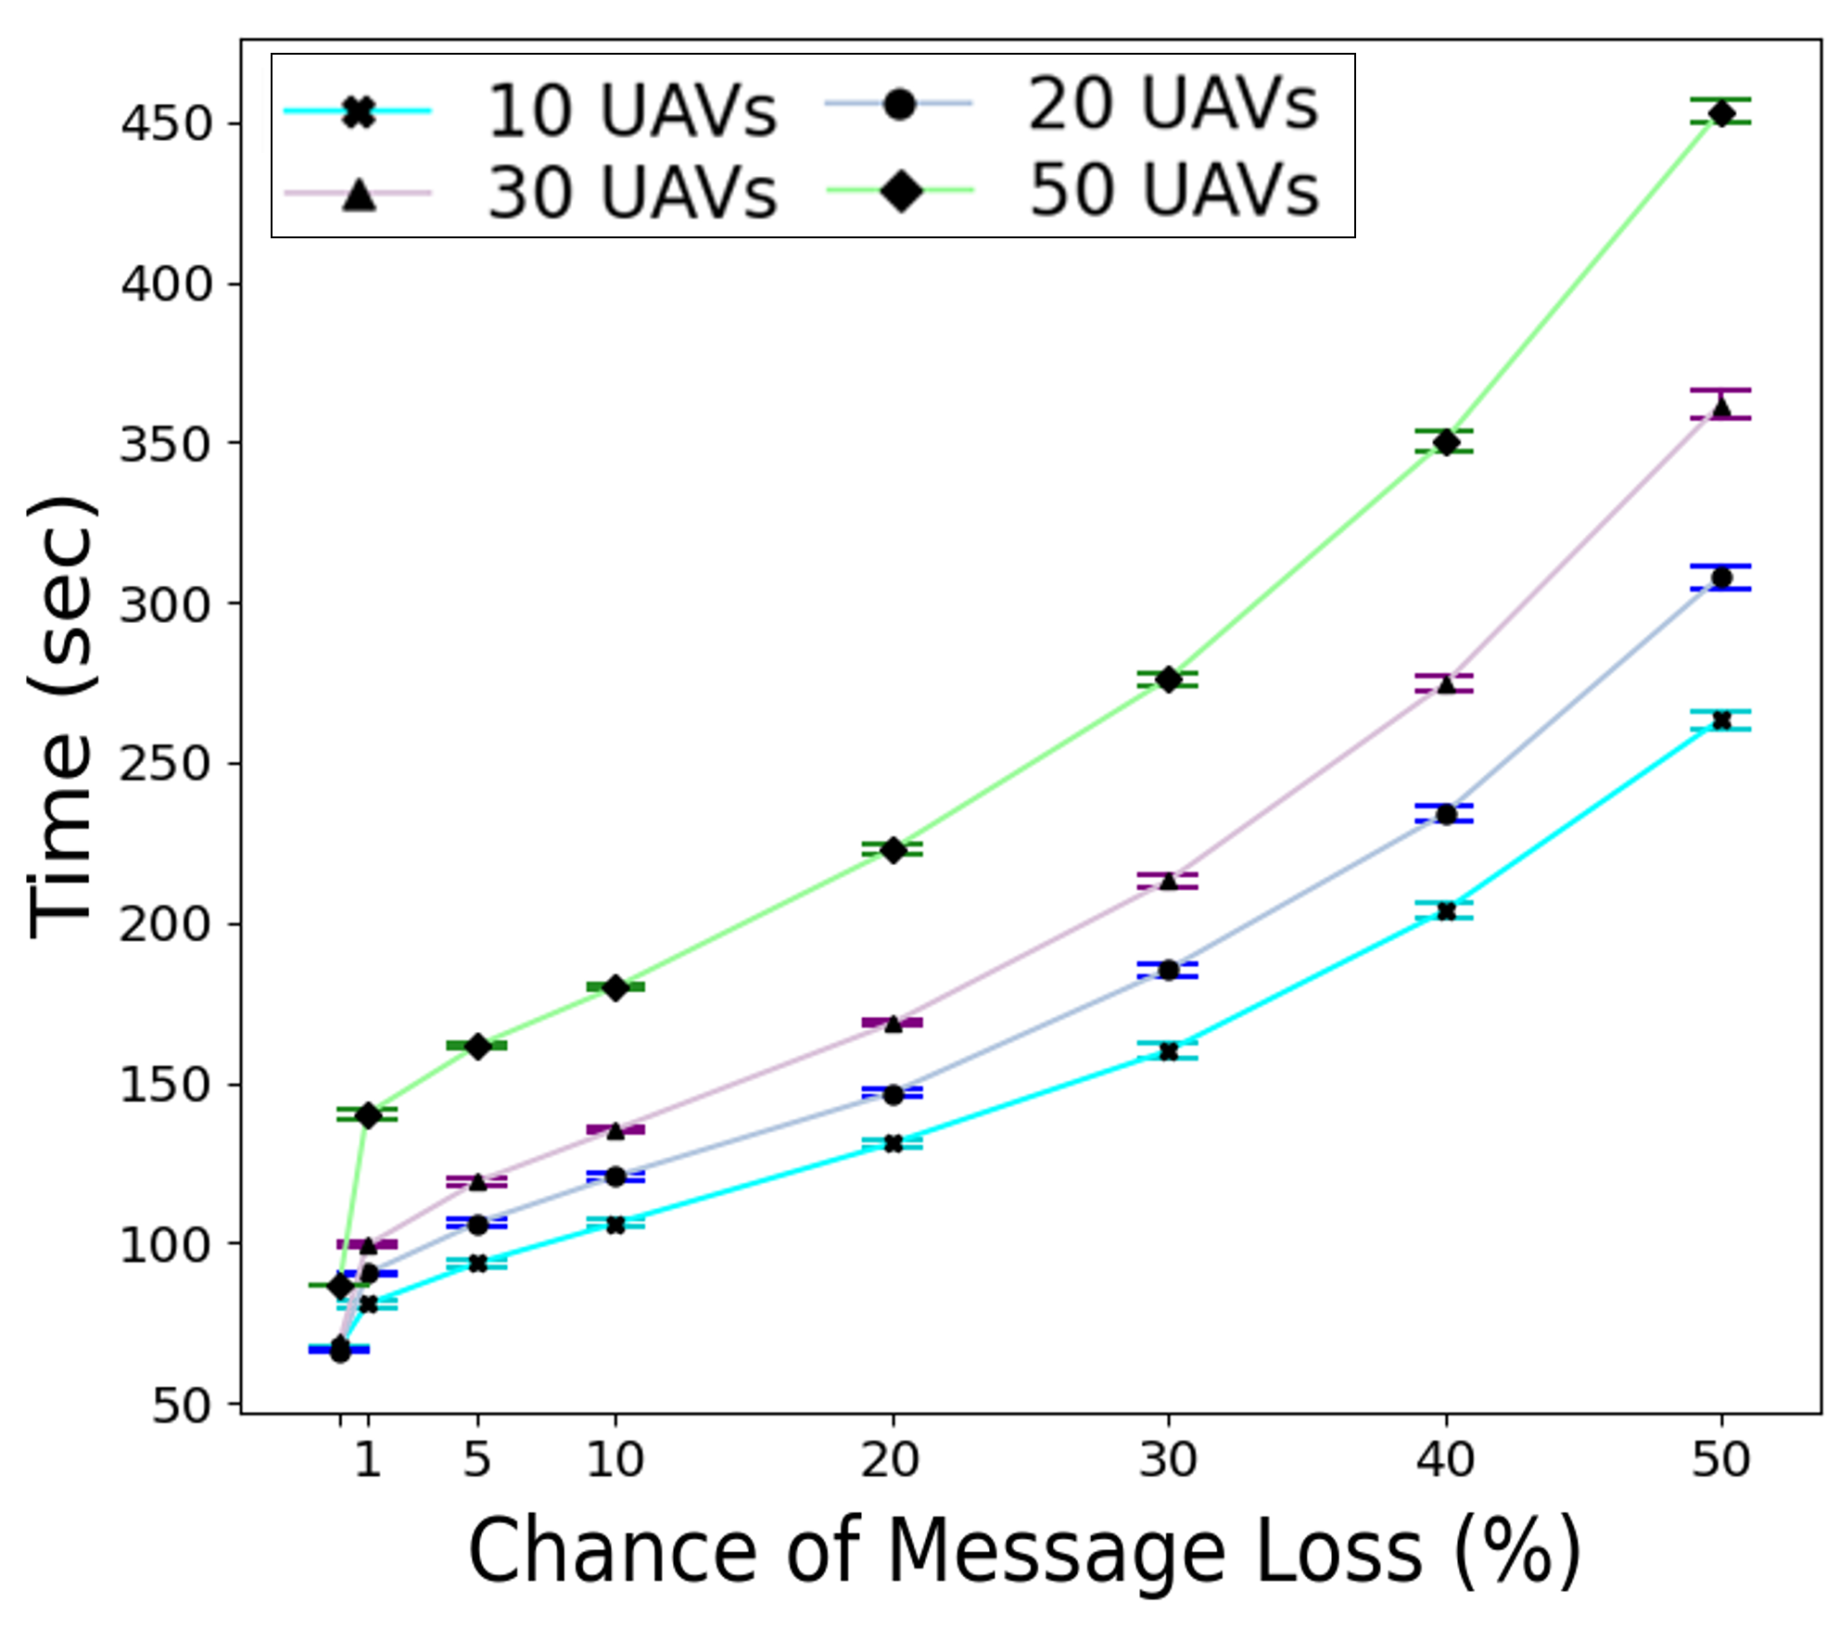
Time Taken

Slide 18
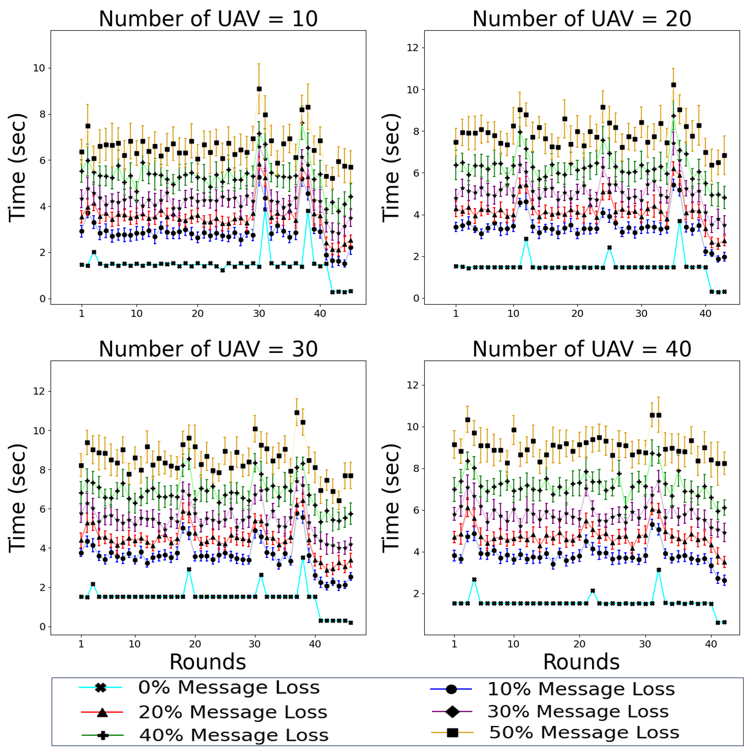
Time Per Round

Slide 19
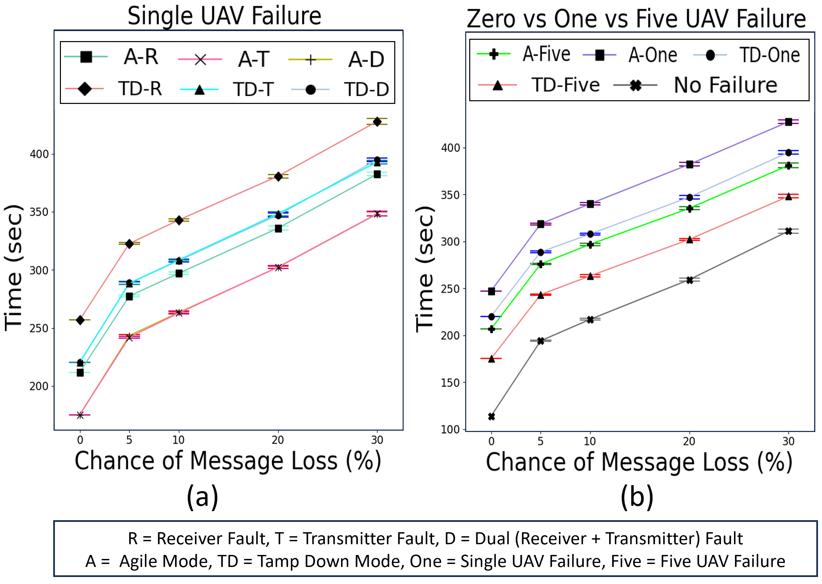
Time - UAV Loss

Slide 20
CLOSING REMARKS

Slide 21
SUMMARY & FUTURE WORK
We have designed an algorithm that guarantees partial synchronization in a distributed multiparty system
Our algorithm is generic and can be applied to platoons engaged in any mission that requires state coordination via sharing of information
Through an exemplar problem, we have shown that our algorithm guarantees mission completion and correctness.
In future, we plan to adapt our approach to the case of limited UAV-to-UAV communication range and multi-hop communications.
It would also be of interest to demonstrate an approach for allowing UAV failures to be temporary,

Slide 22
Thank you

